Slide 1
Chapter 1
Psychology is a Way of Thinking

Slide 2
Agenda
Producers and Consumers of Science
How Scientists Work
Being a Good Producer of Science
Being a Good Consumer of Science
Research Activity 1
Next time on PSY 270…

Slide 3
Producers and Consumers of Science
Everyone interacts with science, be it as a producer, consumer, or both
As a producer…
  Psychology coursework
  In graduate school
  In a research lab
As a consumer…
  Taking medication
  Trying a new workout
  Driving a car
  Many, MANY more…

Slide 4
Talk It Out
What kinds of jobs would require producer-of-research skills?
What kinds of jobs would require consumer skills?

Slide 5
How Scientists Work

Slide 6
How Scientists Work
Scientists are empiricists
Scientists test theories: the theory-data cycle
Scientists work in a community
Scientists tackle applied and basic problems
Scientists make their work public
Scientists talk to the world: from journal to journalism

Slide 7
Scientists are Empiricists
Empiricism – using evidence as the basis for conclusions
  Evidence-based treatments – treatments that have been based on research
  Quantitative methods – turn empirical observations into numbers
  Qualitative methods – create rich descriptions not simplified into numbers
    Reflexivity – Scientists self-consciously consider how their background or privilege shapes what questions they ask and what interpretations they make (acknowledging their own biases)

Slide 8
Talk It Out
Canvas stops working. What do you do?

Slide 9
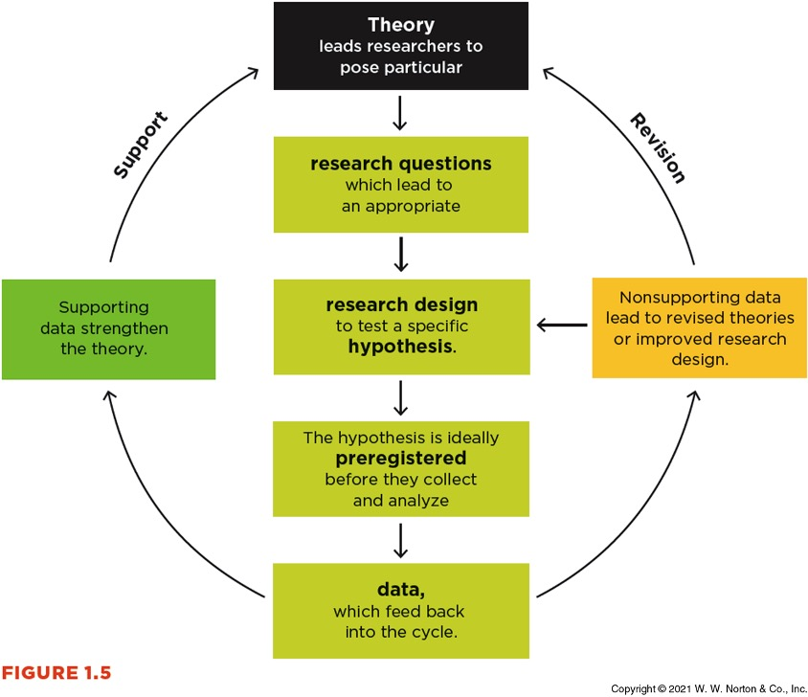
The Theory-Data Cycle
Theory – A set of statements that describes general principles about how variables relate to one another
Hypothesis – Predictions about the outcomes of your research based on theory
Data – Set of observations

Slide 10
The Theory-Data Cycle Example
Why do young animals form attachments to their mothers?
Cupboard theory- the mother provides food
Contact comfort theory- the mother provides comfort through physical contact
We have theories > now we can create hypotheses and research designs to test them
  Falsifiable – able to be proven wrong

Slide 11
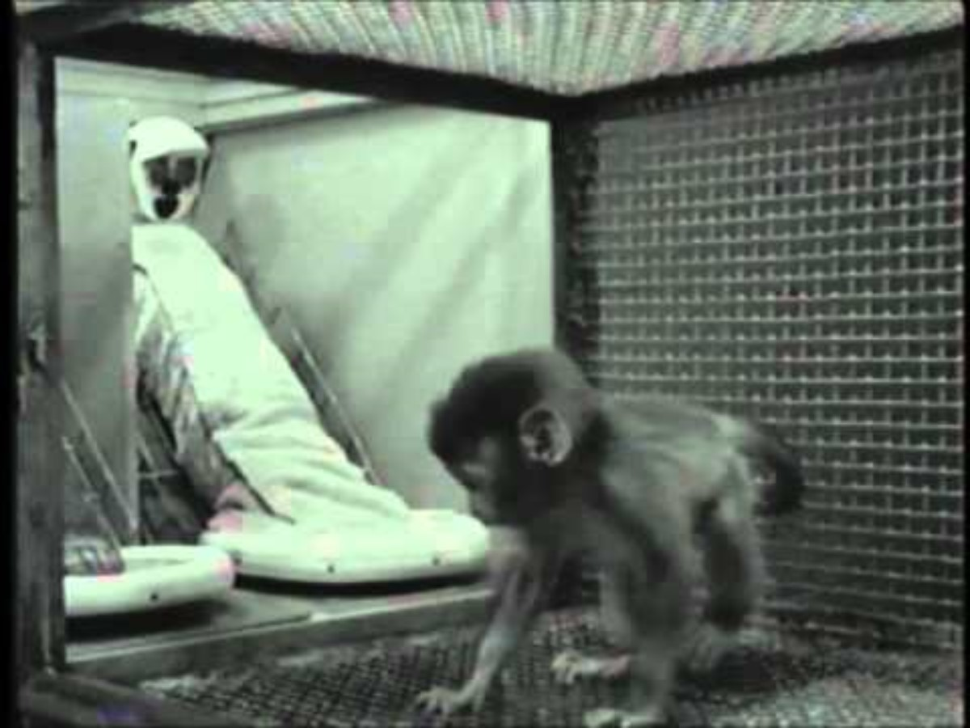
Harlow’s Monkeys
https://www.youtube.com/watch?v=OrNBEhzjg8I

Slide 12
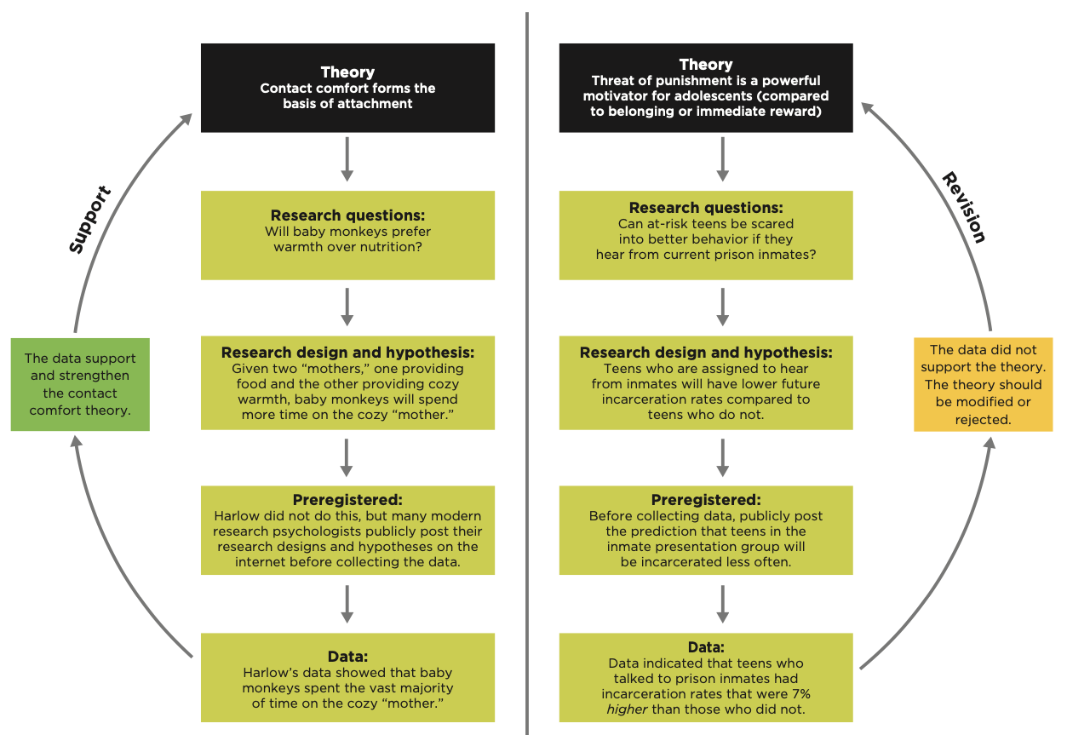
Harlow’s Monkeys Example

Slide 13
Scared Straight Example
Scared Straight: A program where at-risk teens were brought to prisons to see if exposure to the consequences could “scare them straight”

Slide 14
Scientists Work in a Community
Science can be self-correcting: A process in which scientists make their research available for peer review, replication, and critique, with the goal of identifying and correcting errors in the research.
Representation matters
  Representation of different scientists > different problems are addressed
  Representation of different participants > finds can be applied to multiple populations

Slide 15
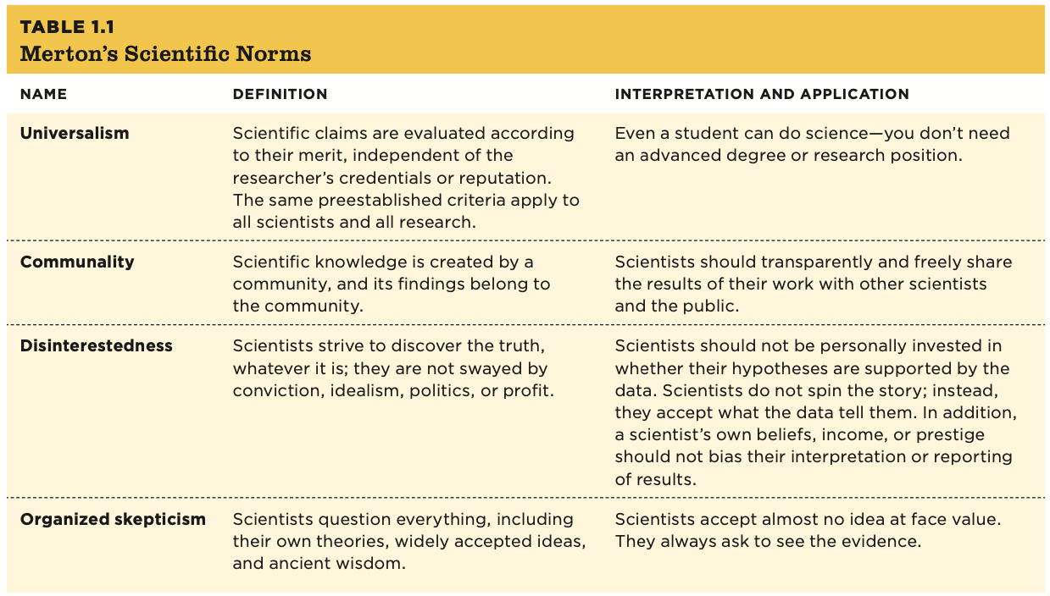
Merton’s Scientific Norms

Slide 16
Scientists Tackle Applied and Basic Problems
Applied research – The goal is to solve practical problems; the findings will be directly applied to finding a solution to a real-world problem.
  Example: Conducting a study to determine if a new method of treating posttraumatic stress disorder is better than the current standard of care
Basic research – The goal is to enhance the general body of knowledge about a particular topic.
  Example: Conducting a study to investigate the changes in the production of cortisol (the stress hormone) throughout the day

Slide 17
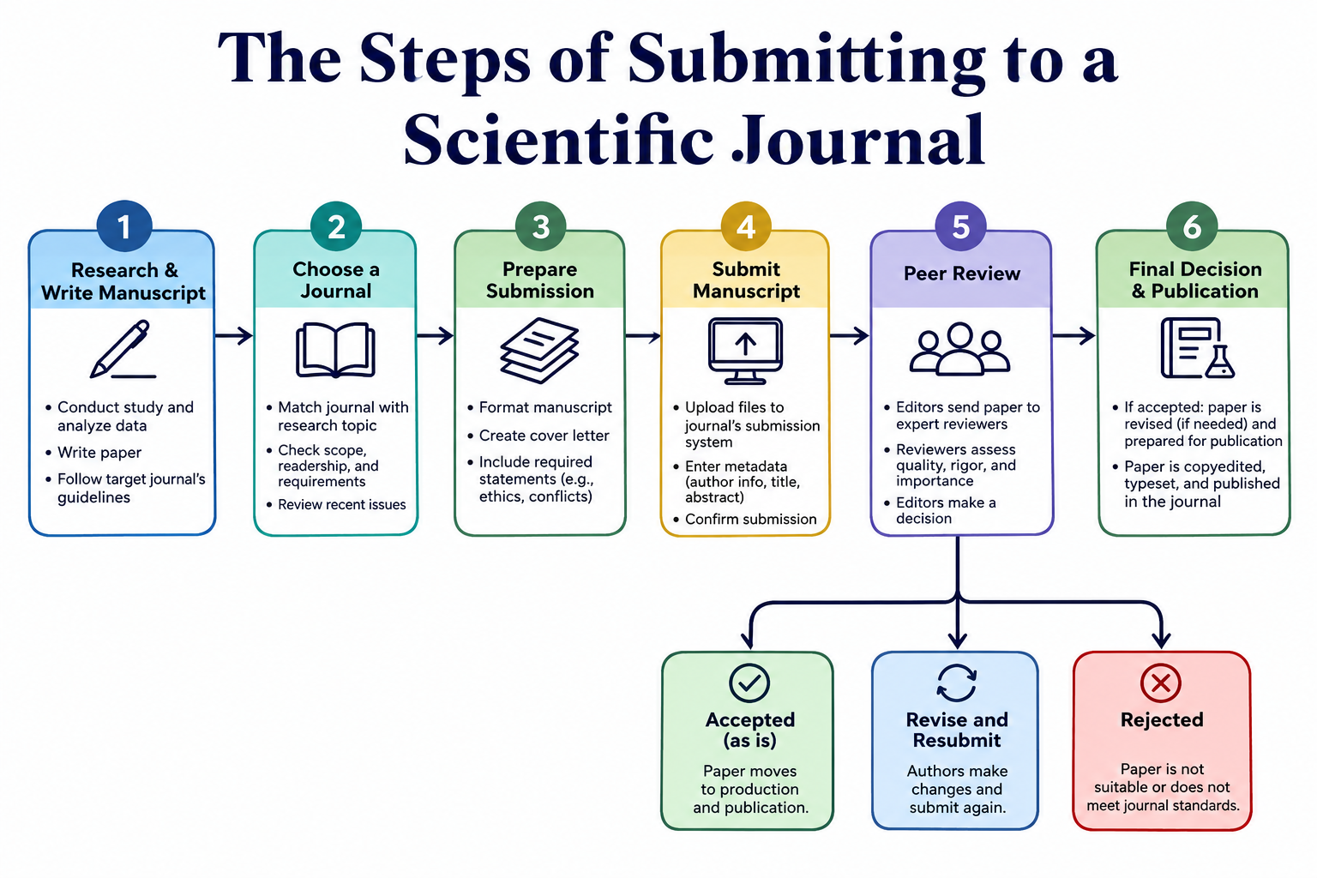
Scientists Make Their Work Public
Scientists share their work by publishing it in a journal (if they can)

Slide 18
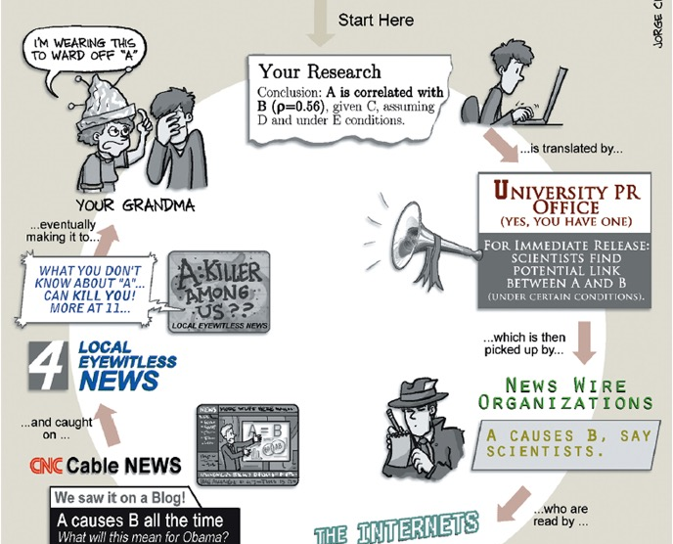
Scientists Talk to the World
Once research is published in a scientific journal, it may be shared with the world through journalism (the media/ press)

Slide 19
The Importance of Being a Good Producer of Science

Slide 20
The Replication Crisis
In the 2000’s/ 2010’s, attention was drawn to a substantial number of studies not being replicable
  Replicable – when the study is repeated and similar results are found
This drew attention to many issues in academia, including the publish-or-perish requirements, the inequity of resources, the file drawer effect/ publication bias, and unethical research practices
As a result, science shifted towards Open Science. This includes a push for open data, open sources, open methodology (including pre-registration), and open resources

Slide 21
The Importance of Being a Good Consumer of Science

Slide 22
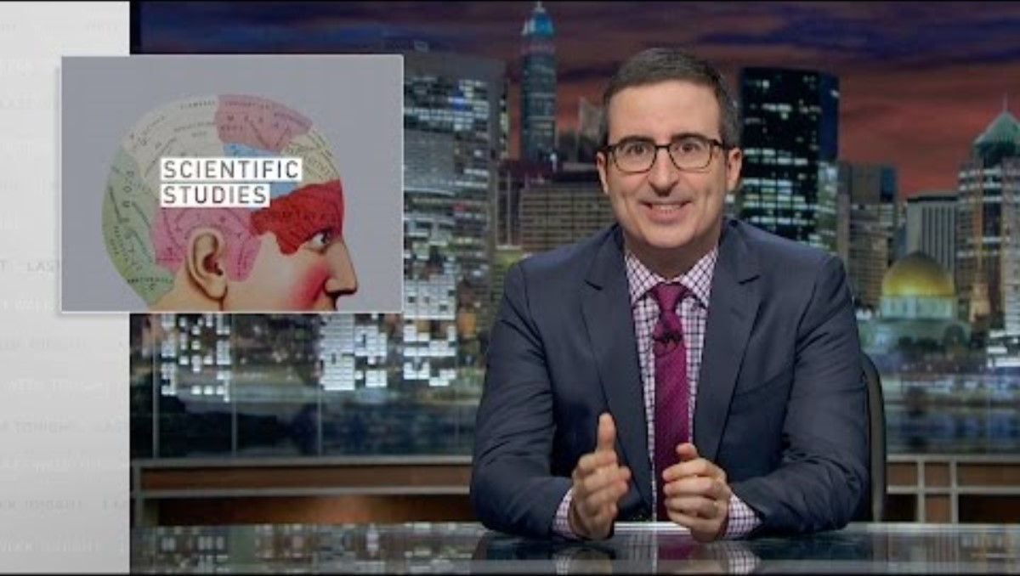
https://www.youtube.com/watch?v=0Rnq1NpHdmw

Slide 23
Check and Reflect
What happens to a theory when the data do not support the theory’s hypotheses? What might a scientist say and do if the data fail to support the theory?
Why can’t theories be proved in science?
Merton proposed four norms that people in the scientific community strive to follow. How many can you name without looking back?
Describe at least two ways journalists might distort (intentionally or not) the science they attempt to publicize

Slide 24
Next Time on PSY 270…
Before Next Class(es):
Complete “How to Use InQuizitive” assignment
  Due 8/28 at 11:59 pm
Read Chapter 1 and complete Ebook: Chapter 1 assignment
  Due 8/28 at 11:59 pm
Complete InQuizitive: Chapter 1
  Due 8/28 at 11:59 pm
Next Class:
Chapter 2: Sources of Information: Why Research is Best and How to Find It

